Slide 1

Does a higher budget determine how lucrative a movie profit?
Team #3

Slide 2

Datasets
OMDb
Popularity - Only 9,043 data available out of 84,294 titles
Kaggle
Netflix titles -568 titles with data available for only 44 original titles
TMDb
Budget
IMDb
Movie Titles
Revenue
Genres
IMDb Ratings

Slide 3

Act 2 - Cass

Slide 4
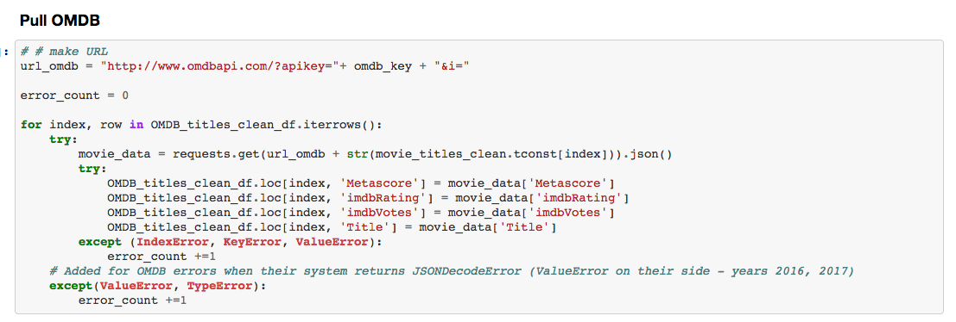

Slide 5
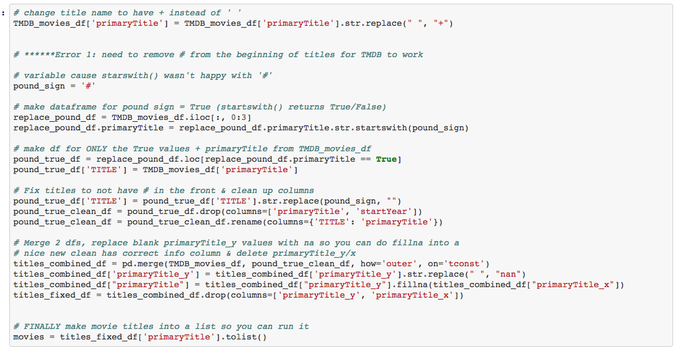

Slide 6
Act 3 – Sriven

Slide 7
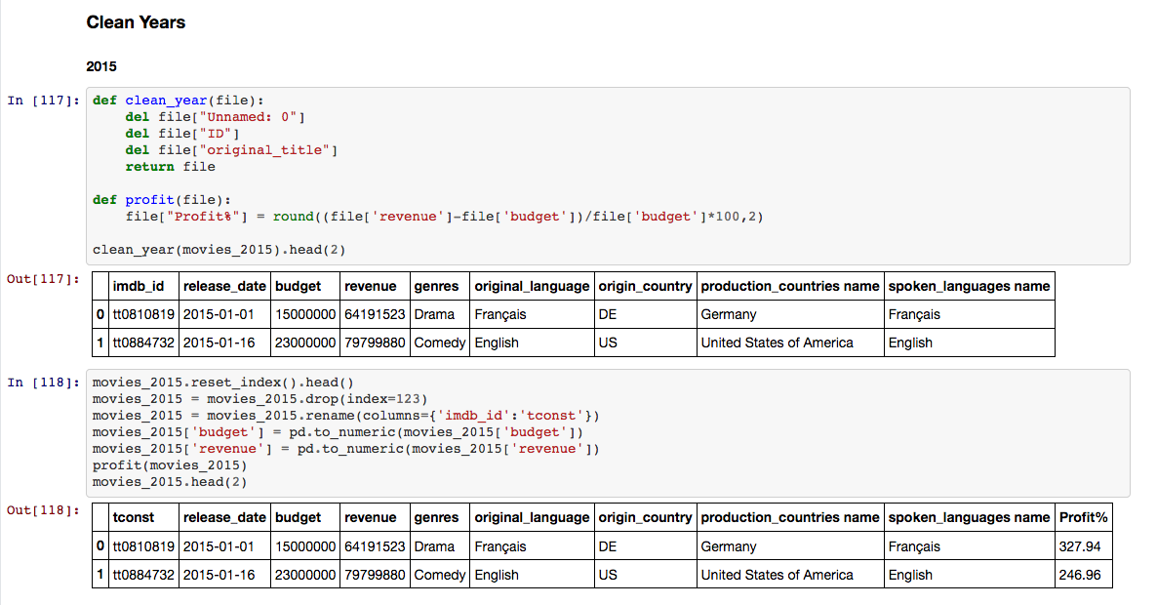

Slide 8
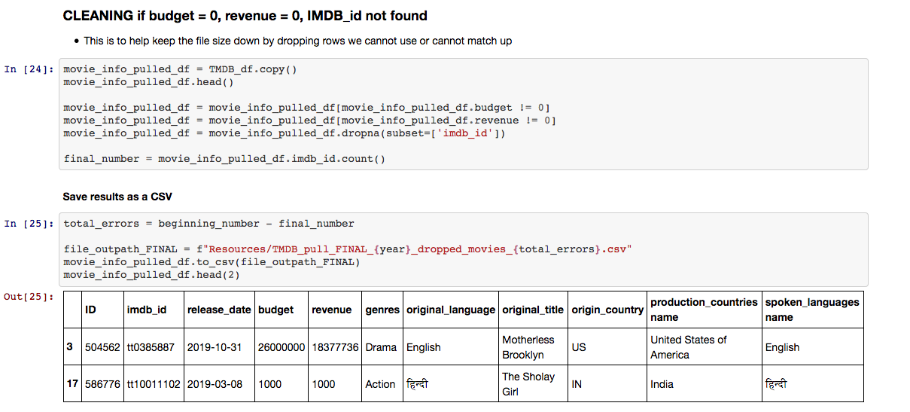

Slide 9

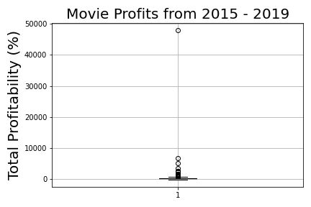
Identifying Outliers
Remove outliers for analysis

Slide 10
Does a higher budget yield a more lucrative profit?
Which Genre yields the most profit?
Act 5 – Joshua

Slide 11
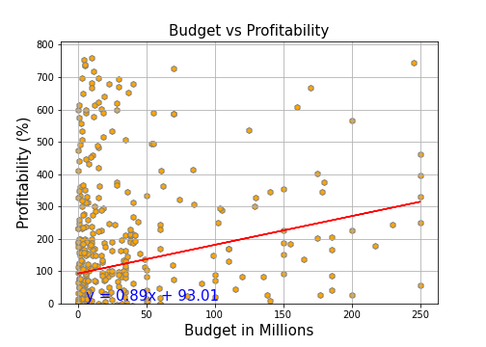
R-squared 0.04

Slide 12
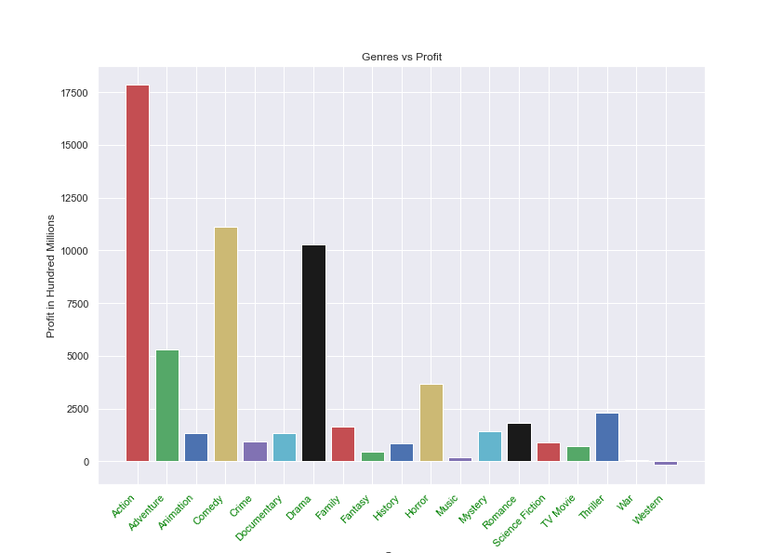

Slide 13
Correlation in top 3 genres?
Take 6 - Lindsey

Slide 14
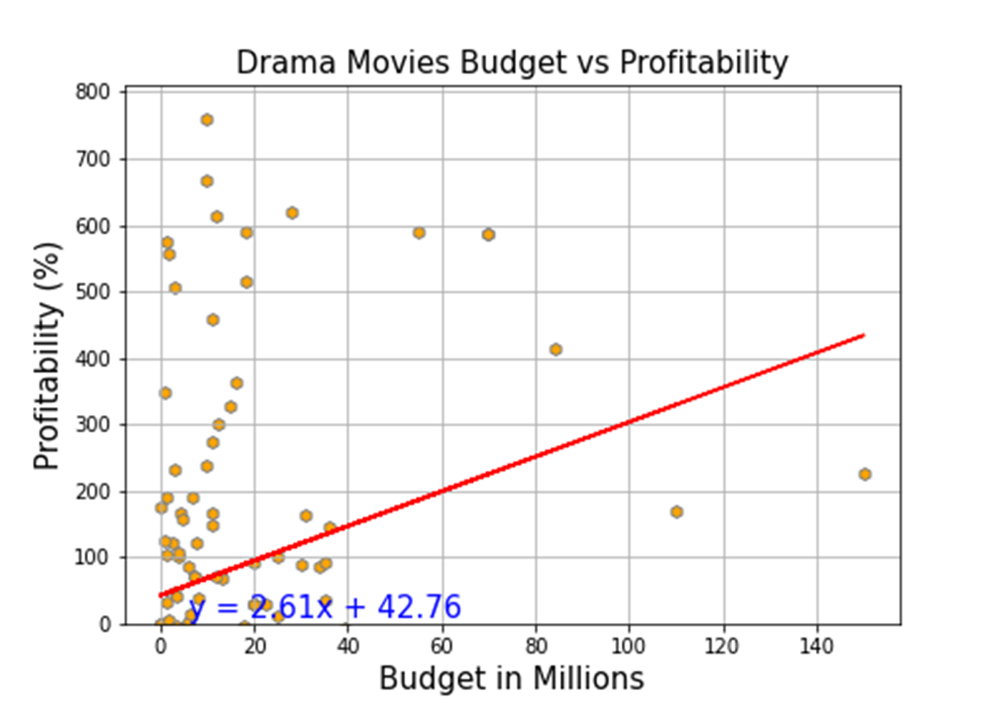
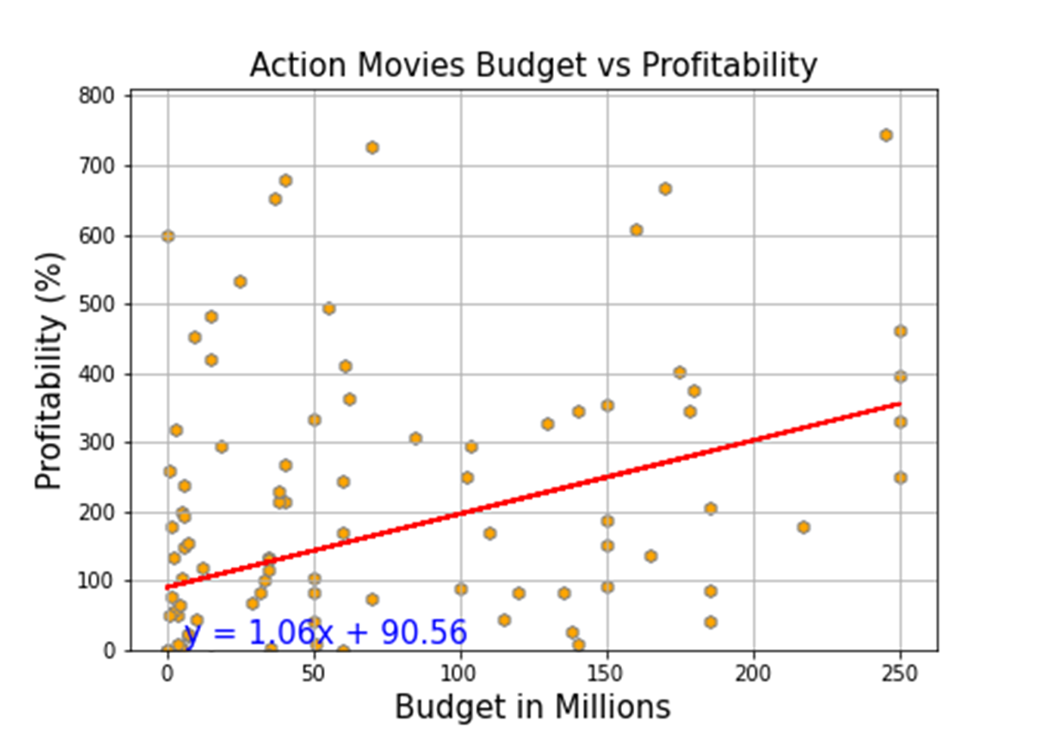
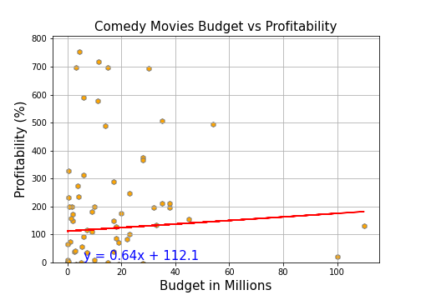

Slide 15
Is there a difference
between the US and Internationally?
Act 7 - Arpi

Slide 16

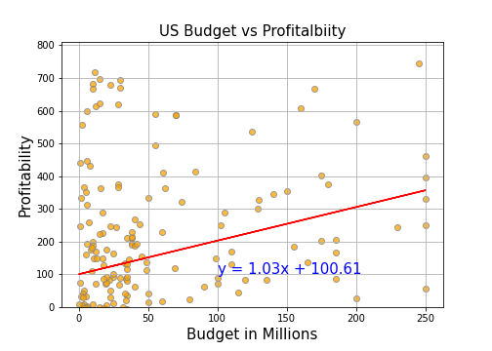
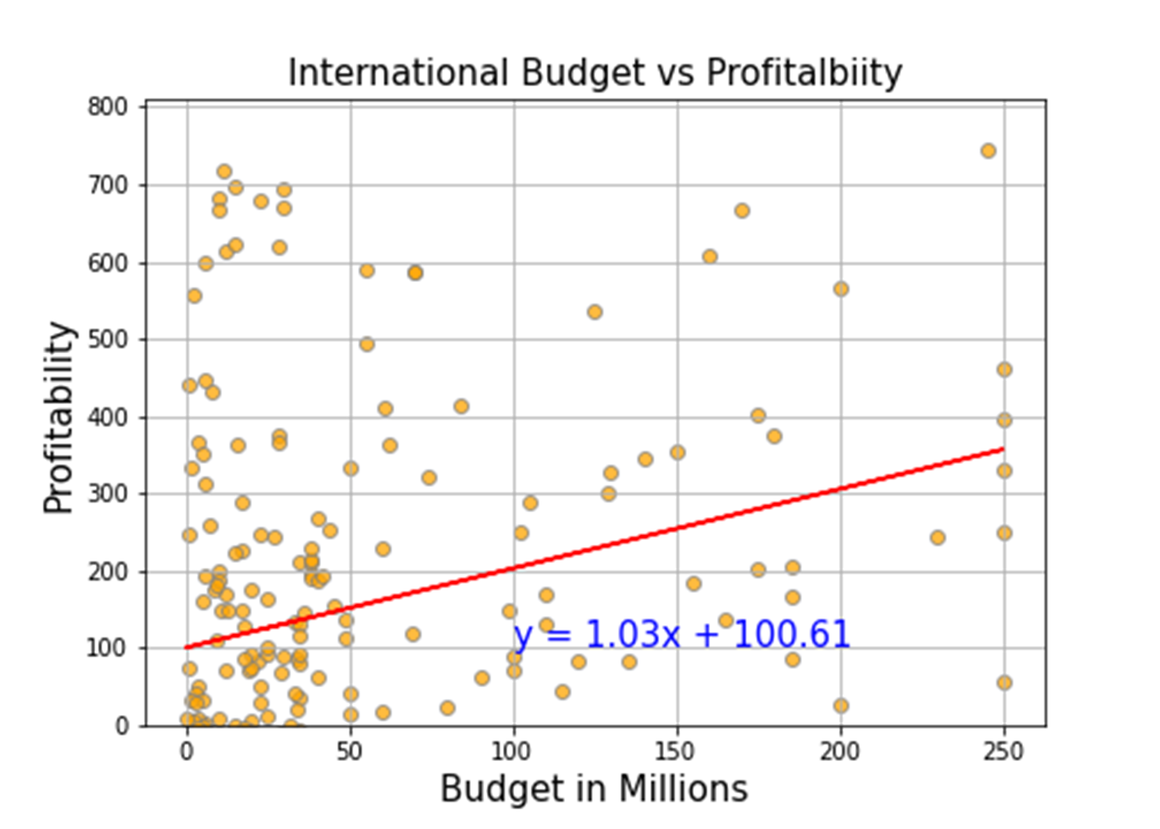
R-squared 0.08
R-squared 0.08

Slide 17

In conclusion
A larger budget does not automatically make a more lucrative movie.

Slide 18

Starring
Amandeep Brar Arpine Bankikyan
Cassie Folkers Lindsey Giron
Ricardo Negrete Sriven Ankam
Featuring
TMDb (The Movie Database)
IMDb
OMDb
Netflix

